Slide 1
ERASMUS
Committee Meeting
23 September 2019
2013
2016
Notes:
21:47
AGÜ Gençlik Fabrikası
Gençler için gençlerle birlikte daha iyi bir topluma...
Türkiye’de bir ilk olan Gençlik Fabrikası:
• gençleri eğiten,
• yaratıcı ve girişimci olmaya teşvik eden,
• gençlere yaşama dair beceriler kazandıran,
• uluslararası vizyon katan,
• gençlerin toplumsal hayata katılımını sağlayıp bir arada öğrenmenin ve üretmenin keyfine vardıran,
• ulusal ve uluslararası boyutta faaliyet gösteren öğrenen odaklı bir yapıdır.

Slide 2
Agenda Items
Presentation of quotas, agreements and mobility numbers of the last year
Discussion on the next plans and meetings
Discussion on the selection of students and staff for the new term project
2013
2016

Slide 3
Outgoing Mobility Numbers 2015-2019
OUTGOING STUDENTS
Erasmus Study Mobility : 55
Erasmus Internship: 82
Erasmustern: 103
Exchange: 10
OUTGOING STAFF
Teaching staff: 21
Training staff:19
Erasmustern Training:4 AGU+6
2013
2016

Slide 4
Incoming Mobility Numbers 2015-2019
Erasmus: 1 Master student from Czech Technical University in Prague (Czech Republic): Electrical and Computer Engineering
1 Master Student from University of Sevilla(Spain): Industrial Engineering
Exchange: 13 Students
2018: 5
2019: 8
From Malaysia, Pakistan, Azerbaijan
Staff: 10 Staff
From Greece, Romania, Crotia, France
2013
2016

Slide 5
Erasmus@AGU 2015-2018
Department | Study 2016 | Study 2017 | Study 2018 | Study 2019 | Internship 2016 | Internship 2017 | Internship 2018 | Internship 2019
Architecture | 3 | 2 | 3 | 3 | 4 | 4 | 1 | 4
Business Administration | 0 | 3 | 3 | 5 | 2 | 4 | 0 | 5
Civil Engineering | 1 | 4 | 3 | 3 | 2 | 0 | 0 | 1
Computer Engineering | 2 | 2 | 0 | 4 | 0 | 3 | 4 | 8
Electrical and Electronics | 4 | 0 | 3 | 3 | 1 | 0 | 2 | 5
Industrial Engineering | 0 | 0 | 0 | Spring | 3 | 11 | 4 | 1
Mechanical Engineering | 1 | 0 | 0 | 2 | 1 | 5 | 1 | 4
Molecular Biology | X | 0 | 0 | 1 | X | 0 | 2 | 4
2013
2016

Slide 8
Problems of mobilities
International Students’ visa problems and last minute cancellations
Some of our partner universities ask for national language and they do not open English courses
Agreement numbers for some departments
Some of our partners do not extend agreements
Difficulty to find internship places (2019 is the best)
For staff mobility, the same applications
For exchange, the students are not interested since it is without grant
The number of students attending Info Days is not enough
Erasmus Proficiency exam is very hard
2013
2016

Slide 9
Solutions
We should do new agreements by using departments’ network
Academics may help students to find internship places
We may organize workshops about Exchange opportunities.
We may visit our Alumni’s companies and ask for the internship opportunities.
We may invite people in charge from foreign companies.
We may change minimum passing score of English exam for EXCHANGE mobility.
We should increase the number of incoming students and staff by promoting our university among partner University students
For promotion, departments may organize workshops and staff weeks and we may invite staff from partners.
By using exchange partners, departments may write KA107 projects
2013
2016

Slide 10
Student Mobility Process 2020
Applications
Announcement of nominations
Erasmus Exam
% 50 GPA x % 50 Exam results
Call
Choosing Internship or study mobility
2013
2016

Slide 11
Erasmus@AGU 2019-2021
Erasmus and Exchange Call: In December
Exam date: ?
Minimum passing score for the English Proficiency Exam?
17 study mobility
30 internship mobility
UNTIL 2021
Quota distribution between the departments?
2013
2016

Slide 12
Exchange@AGU Previous years
Department | Agreements | Exchange mobility used Previously
Architecture | 20 | 7
Business Administration | 34 | 2
Civil Engineering | 17 | 0
Computer Engineering | 26 | 0
Electrical and Electronics | 17 | 0
Industrial Engineering | 27 | 0
Mechanical Engineering | 18 | 1
Molecular Biology | 4 | 0
Problems for Exchange
Only 10 Students
-No funding
-Course matches
-Exam minimum passing score !
2013
2016

Slide 13
Staff Mobilty@AGU
Department | Teaching | Training
Architecture | 3 | 0
Business Administration | 7 | 0
Civil Engineering | 1 | 0
Computer Engineering | 2 | 2
Electrical and Electronics | 2 | 4
Industrial Engineering | 0 | 1
Mechanical Engineering | 2 | 1
Economics | 5 | 1
International Office | 0 | 5
Educational Sciences | 0 | 3
School Of Languages | 0 | 4
Political Science and Public Administration | 0 | 1
2013
2016

Slide 14
Staff Mobilty@AGU 2018-2020
 | Number | Dates
Teaching Mobility | 11+ 4 left from previous project until 2020 Total: 15 | Until 2021
Training Mobility | 5 | Until 2021
2013
2016

Slide 15
New Applications
Name | Department | Experience | Country | Institution | Dates | Mobility Type
Burcu Güngör | CENG | 6 years | Spain | Barcelona Supercomputing Center | 25-29 November 2019 | Training
Tansel Karagöz | Economics | 1 year | France | Université Savoie Mont Blanc (USMB) | 14-19 October 2019 | Training
Elif Bengü | Educational Sciences | 3 Years | Denmark | Aalborg University | 27-30 October 2019 | Teaching
2013
2016

Slide 16
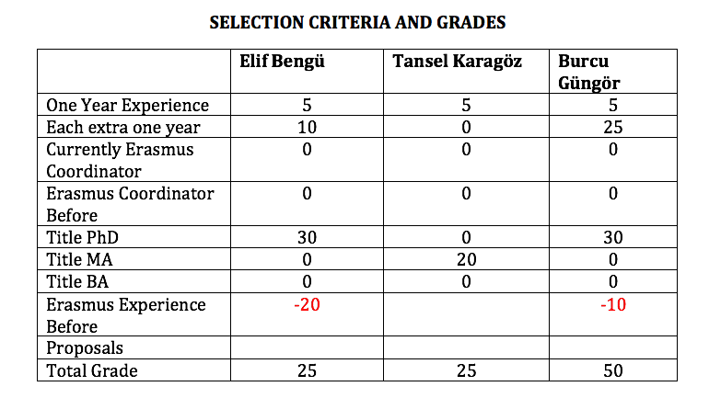
New Applications
2013
2016

Slide 17
Erasmus@AGU 2019-2021
Criteria for staff mobility:
At least one year of work experience at AGU: + 5 points
For each extra year of work experience at AGU: + 5 points
Currently, Erasmus Department Coordinator/Assistant: +10 points
Previous Erasmus Department Coordinator/Assistant: + 5 points
First time Erasmus applicant: +30 points
Academic personnel of Faculties/Schools with Ph.D. Titles: +30 points
Support academic personnel of Faculties/Schools with M.Sc./M.A Titles: +20 points
Support academic personnel of Faculties/Schools with B.Sc./B.A Titles: +10 points
2013
2016

Slide 18
Erasmus@AGU 2019-2021
Criteria for staff mobility:
Language Level 1 : + 40 points for KPDS/YDS .GE. 90, TOEFL IBT .GE. 108
Language Level 2 : + 30 points for KPDS/YDS .GE. 80, TOEFL IBT .GE. 96
Language Level 3 : + 20 points for KPDS/YDS .GE. 70, TOEFL IBT .GE. 84
Language Level 4 : + 10 points for KPDS/YDS .GE. 60, TOEFL IBT .GE. 72
Here .GE. stands for “Greater than or Equal to”. One can get a Language Point from only one of the Language Levels.
For presentation proposals that introduces the research activities, their budgets and the project based RA scholarships at AGU: +10 points
For presentation proposals that promotes the joint research collaborations between the two institutions: +10 points
For presentation proposals that promotes graduate studies at AGU for candidate grad students: +10 points
For presentation proposals that promotes academic exchange activities between the two institutions: +10 points
For presentation proposals that promotes undergrad and grad student exchange activities between the two institutions: +10 points
2013
2016

Slide 19
What’s next?
Next Call
Next Committee Meeting
Info Days
Departmental Info Days
KA 107 (International Credit Mobility
Strategic Partnership
Mevlana Exchange Program
KA 103
Erasmus Calendar
2013
2016

Slide 20
Thank you for your participation!
2013
2016

