Slide 1
ERASMUS
Committee Meeting
22 April 2019
2013
2016
Notes:
21:47
AGÜ Gençlik Fabrikası
Gençler için gençlerle birlikte daha iyi bir topluma...
Türkiye’de bir ilk olan Gençlik Fabrikası:
• gençleri eğiten,
• yaratıcı ve girişimci olmaya teşvik eden,
• gençlere yaşama dair beceriler kazandıran,
• uluslararası vizyon katan,
• gençlerin toplumsal hayata katılımını sağlayıp bir arada öğrenmenin ve üretmenin keyfine vardıran,
• ulusal ve uluslararası boyutta faaliyet gösteren öğrenen odaklı bir yapıdır.

Slide 2
Agenda Items
Erasmus Staff Presentations
Erasmus Staff Exchange Selections
Erasmus Student Exchange 2019 (left quotas for internship and study mobility)
Discussion on the next plans and meetings
2013
2016

Slide 3
Staff Mobilty@AGU 2018-2020
 | Number | Dates
Teaching Mobility | 2 | Until 2020
Training Mobility | 1 | Until May 2019
2013
2016

Slide 4
New Applications
Name | Department | Experience | Country | Institution | Dates | Mobility Type
Elif Bengü | Educational Sciences | 2,5 years | Spain | Create the future leaders & innovators in the classroom (CLIC) | 20-24 May 2019 | Training
Özgür Aydın | Mechanical Engineering |  | Sweden | Lund University | 12-16 November 2019 | Teaching
2013
2016

Slide 5
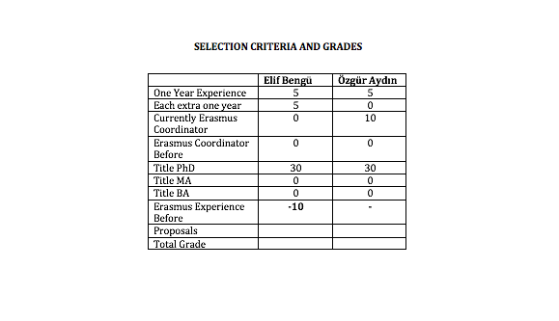
New Applications
2013
2016

Slide 6
Erasmus@AGU 2018-2020
Criteria for staff mobility:
At least one year of work experience at AGU: + 5 points
For each extra year of work experience at AGU: + 5 points
Currently, Erasmus Department Coordinator/Assistant: +10 points
Previous Erasmus Department Coordinator/Assistant: + 5 points
First time Erasmus applicant: +30 points
Academic personnel of Faculties/Schools with Ph.D. Titles: +30 points
Support academic personnel of Faculties/Schools with M.Sc./M.A Titles: +20 points
Support academic personnel of Faculties/Schools with B.Sc./B.A Titles: +10 points
2013
2016

Slide 7
Erasmus@AGU 2018-2020
Criteria for staff mobility:
Language Level 1 : + 40 points for KPDS/YDS .GE. 90, TOEFL IBT .GE. 108
Language Level 2 : + 30 points for KPDS/YDS .GE. 80, TOEFL IBT .GE. 96
Language Level 3 : + 20 points for KPDS/YDS .GE. 70, TOEFL IBT .GE. 84
Language Level 4 : + 10 points for KPDS/YDS .GE. 60, TOEFL IBT .GE. 72
Here .GE. stands for “Greater than or Equal to”. One can get a Language Point from only one of the Language Levels.
For presentation proposals that introduces the research activities, their budgets and the project based RA scholarships at AGU: +10 points
For presentation proposals that promotes the joint research collaborations between the two institutions: +10 points
For presentation proposals that promotes graduate studies at AGU for candidate grad students: +10 points
For presentation proposals that promotes academic exchange activities between the two institutions: +10 points
For presentation proposals that promotes undergrad and grad student exchange activities between the two institutions: +10 points
2013
2016

Slide 8
Erasmus@AGU 2018-2020 Student Mobility
Minimum passing score for total grade is 45 and higher
21 study mobility (9 departments)
22 internship mobility
9 internship Erasmustern
UNTIL 2020
Left quotas
2013
2016

Slide 9
Erasmus@AGU 2018-2020 Internship Mobility
Departments | Internship | Waiting List
Architecture | 4 | 1
Business Administration | 5 | 2
Civil Engineering | 1 | 0
Computer Engineering | 4 | 5
EEE | 4 | 4
Industrial Engineering | 4 | 3
Mechanical Engineering | 4 | 0
Molecular Biology and Genetics | 4 | 1
Total | 29 (extra 1 quota left) | 16
2013
2016

Slide 10
Erasmus@AGU 2018-2020 Study Mobility
Departments | Study Mobility | Waiting List
Architecture | 4 | 3
Business Administration | 4 | 2
Civil Engineering | 4 | 2
Computer Engineering | 3 | 2
EEE | 4 | 0
Industrial Engineering | 0 | 0
Mechanical Engineering | 4 | 1
Molecular Biology and Genetics | 2 | 0
Total | 25 (no quotas left) | 10
2013
2016

Slide 11
Erasmus@AGU 2018-2020 Student Mobility
Problems
Apostil problem for visa
Some of students are paid for the internship
2013
2016

Slide 12
What’s next?
Next Call
Next Committee Meeting
2013
2016

Slide 13
Thank you for your participation!
2013
2016

